Slide 1
Parts of Motherboard

Slide 2
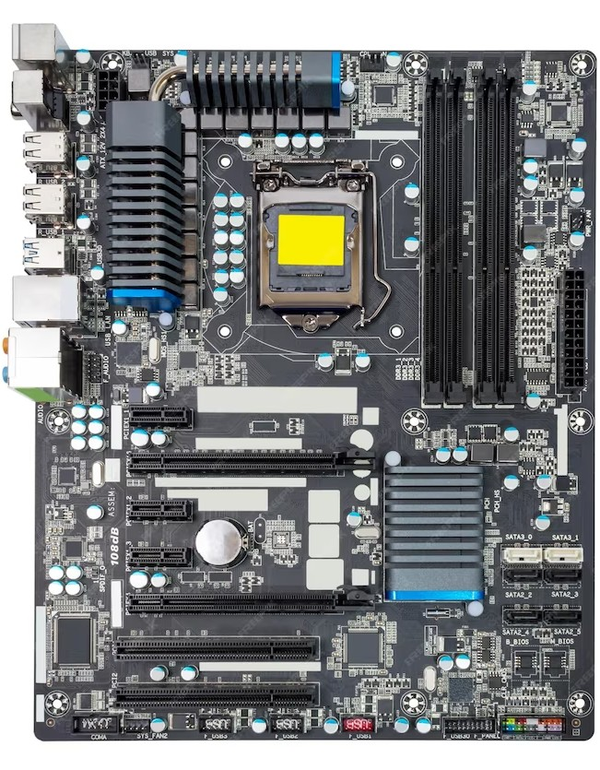
What is Motherboard?
A motherboard is the main printed circuit board (PCB) in a computer. The motherboard is a computer's central communications backbone connectivity point, through which all components and external peripherals connect. Motherboards can be found in virtually all computers, especially desktop and laptop PCs.

Slide 3
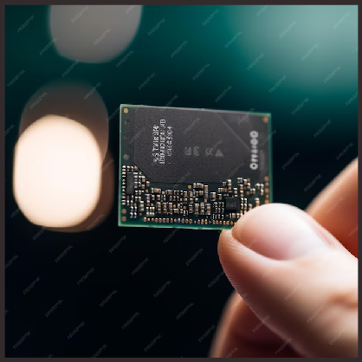
Central Processing Unit (CPU) Slot
In computer hardware, a CPU socket or CPU slot contains one or more mechanical components providing mechanical and electrical connections between a microprocessor and a printed circuit board (PCB). This allows for placing and replacing the central processing unit (CPU) without soldering.

Slide 4
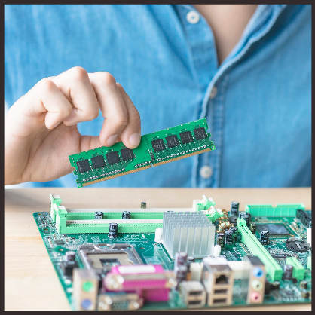
Random Access Memory (RAM) Slot
RAM is the short-term memory of the computer, storing data that the CPU needs to access quickly. Think of it as the computer's workspace, where it juggles multiple tasks at once.

Slide 5
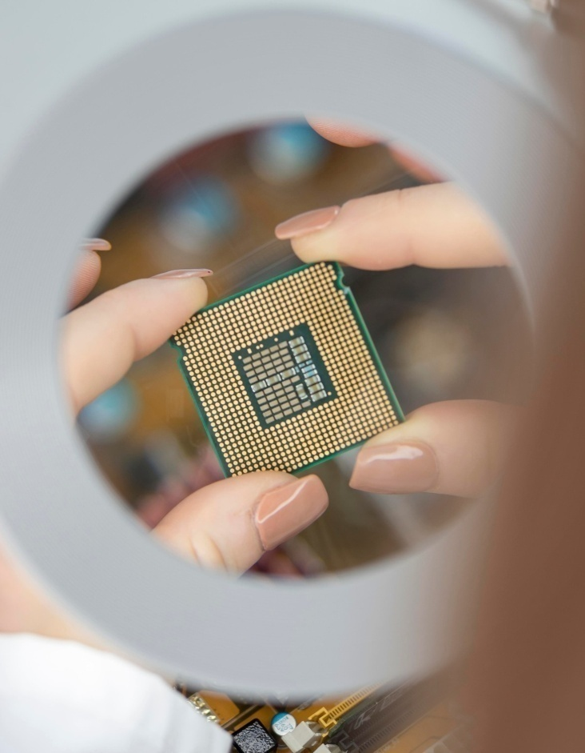
Graphics Processing Unit (GPU)
The GPU is responsible for rendering images and videos, making your visual experience smooth and immersive. It's like the artist behind the scenes, bringing your digital world to life.

Slide 6
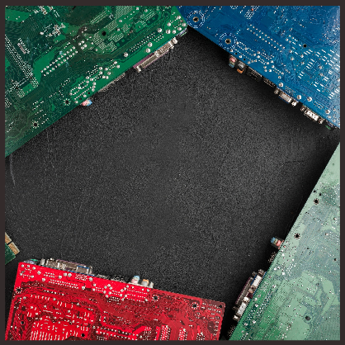
Motherboard
The motherboard is the central hub that connects all the components of the computer. It's like the bustling city center, where all roads lead and activities converge.

Slide 7
The PSU is the energy source that fuels the entire system, providing the necessary power for all components to function. It's like the heart pumping blood to keep the body alive.

Slide 8
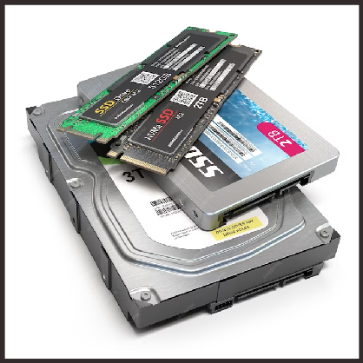
Storage Devices
Hard drives and SSDs are the storage solutions that hold all your data, from operating systems to personal ﬁles. They're like the library archives, preserving and retrieving information when needed.

Slide 9
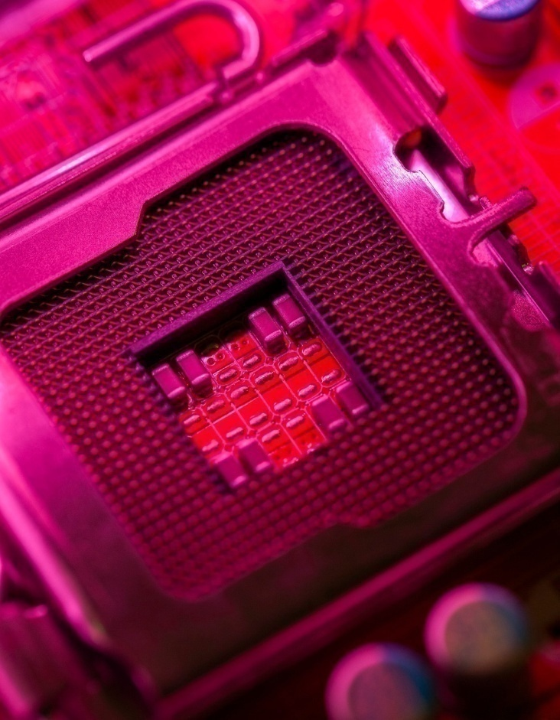

E pansion Slots
These slots allow you to add extra components like sound cards, network cards, and more. It's like having extra rooms in your house, ready to accommodate new guests and expand your living space.

Slide 10
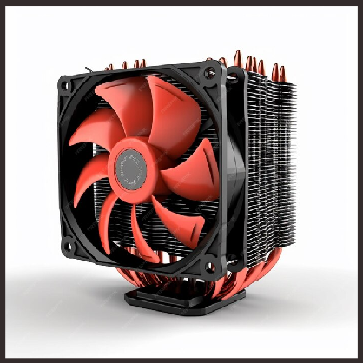
Cooling System
The cooling system keeps the components from overheating, ensuring smooth operation. It's like the air conditioning in a building, maintaining a comfortable environment for everyone inside.

Slide 11

BIOS and UEFI
BIOS and UEFI are ﬁrmware that initialize the hardware and load the operating system. They're like the stage directors, setting the scene and preparing the actors for the show.

Slide 12
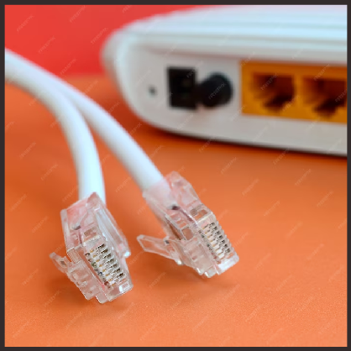
Connectivity Ports
USB, HDMI, Ethernet, and other ports provide the means to connect external devices. They're like the doors and windows of the computer, allowing communication and interaction with the outside world.

Slide 13
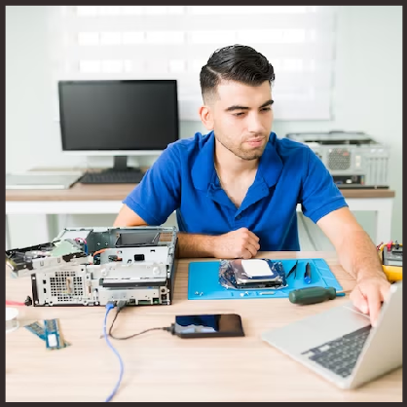
Troubleshooting Tips
Understanding the components can help diagnose and ﬁx hardware issues. It's like having a map to navigate through the city, ﬁnding your way when things go wrong.

Slide 14
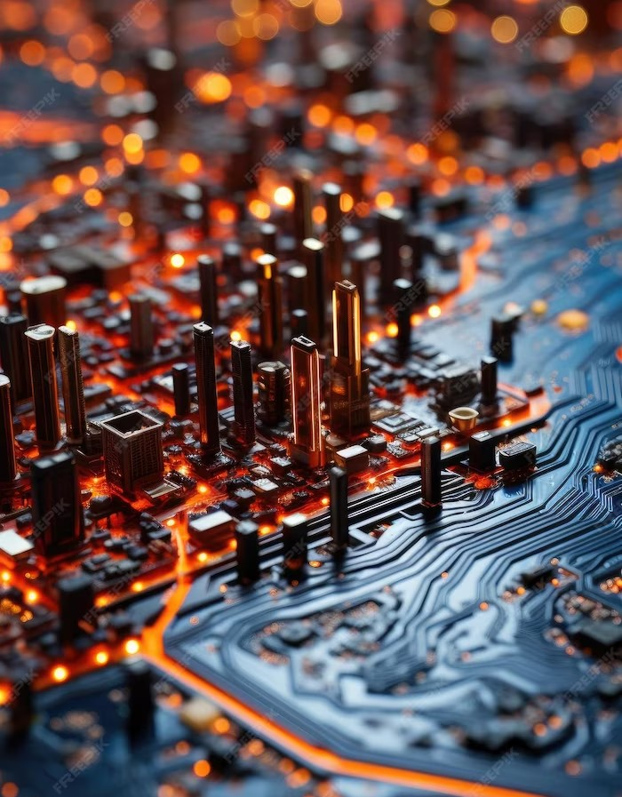
Unveiling the Secrets
Exploring the components of a motherboard has revealed the intricate and essential elements that power our digital world. Embrace the knowledge and continue to marvel at the wonders of technology.

Slide 15
Thanks!
Speacially thanks for Saru Chamlagain

